Slide 1

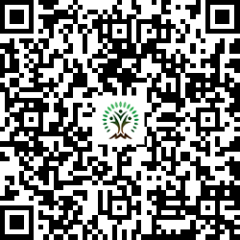


IONIQ Forest
Grid – E Zones 1 -10

Slide 2
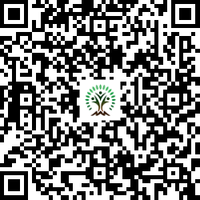
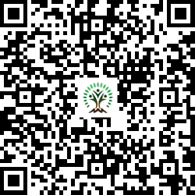
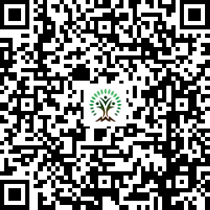
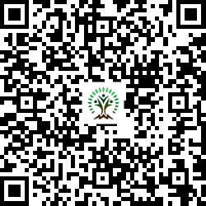
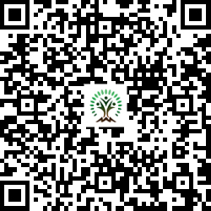
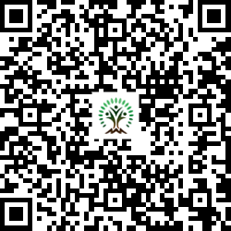
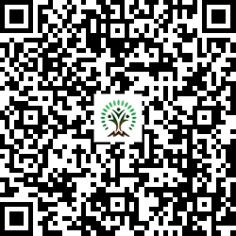
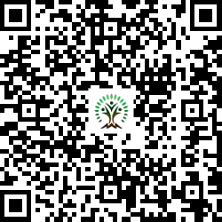
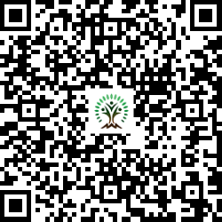
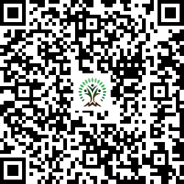
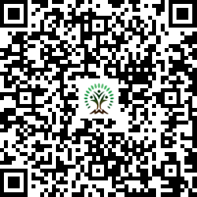
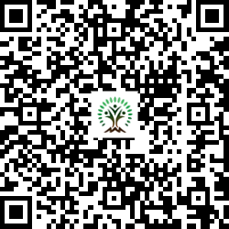
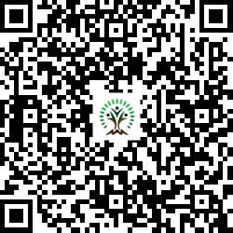
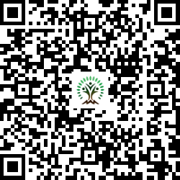
Sr. No. | Scientific Name | Common Name | QR Code
1 | Aegle marmelos | Wood Apple
2 | Anacardium occidentale | Cashew
3 | Annona squamosa L | Custard apple
4 | Azadirachta indica | Neem Tree
5 | Bauhinia variegata | Orchid Tree
6 | Cassia fistula | Golden shower tree
7 | Dalbergia sissoo | Indian rosewood
Sr. No. | Scientific Name | Common Name | QR Code
8 | Lagerstroemia speciosa | Pride of India
9 | Melia dubia | Malabar Neem
10 | Mimusops elengi | Spanish cherry
11 | Neolamarckia cadamba | Burrflower tree
12 | Phyllanthus emblica | Indian gooseberry
13 | Pongamia pinnata | Indian Beech Tree
14 | Psidium guajava | Guava

Slide 3
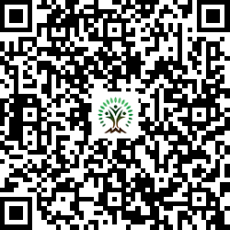
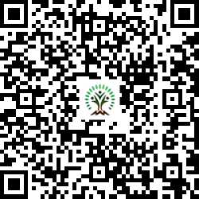
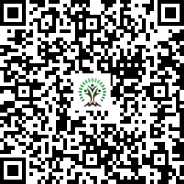
Sr. No. | Scientific Name | Common Name | QR Code
15 | Tamarindus indica L. | Tamarind
16 | Terminalia arjuna | White Murdah
17 | Toona ciliata | Indian mahogany

